Slide 1

Imputation
Genetic epidemiology short course
Tutor: Gibran Hemani
Email: g.hemani@bristol.ac.uk

Slide 2
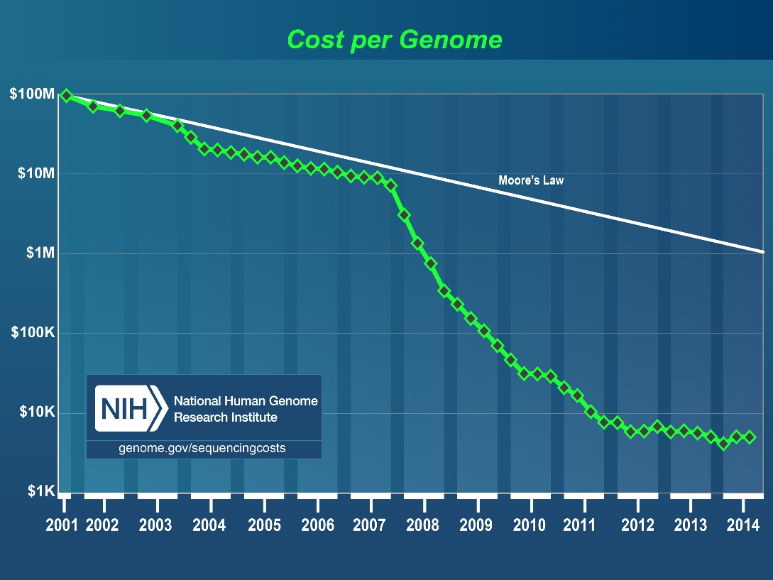
Sequencing costs
The cost per sequenced genome has fallen rapidly in the fifteen years since the publication of the human genome sequence due to improvements in sequencing technology
However it is still too expensive to sequence large number of subjects
Notes:
The cost per Genome has dropped at the same time, but it is still too expensive to conduct large studies where each sample is sequenced to a level similar to publically available resources.
At the time of the Human Genome Project the cost was 1 billion
By July 2014 it was 5 thousand
Exome sequencing, where only genic regions are sequenced costs about 500 to 1 thousand dollars
Chip based genotyping costs in the 100 dollar range.
Imputation allows the use of information from different samples in a second sample that does not contain as many markers.
In this way it allows more markers to be tested without the associated costs of having to actually genotype subjects at those sites.

Slide 3
Overview
The objective of GWAS is to identify genetic variants associated with a phenotype in order to
1. Improve prediction
2. Improve understanding of the disease
Imputation is crucial to both objectives because it
1. Improves statistical power by
a) Getting closer to the causal variant
b) Enabling meta-analysis to operate on much larger sample sizes
c) Fix genotype errors
2. Enables fine mapping

Slide 4
Contents
What contributes towards a P-value being low?
The imputation process
Phasing
Reference panels
Assessing quality
Meta analysis

Slide 5
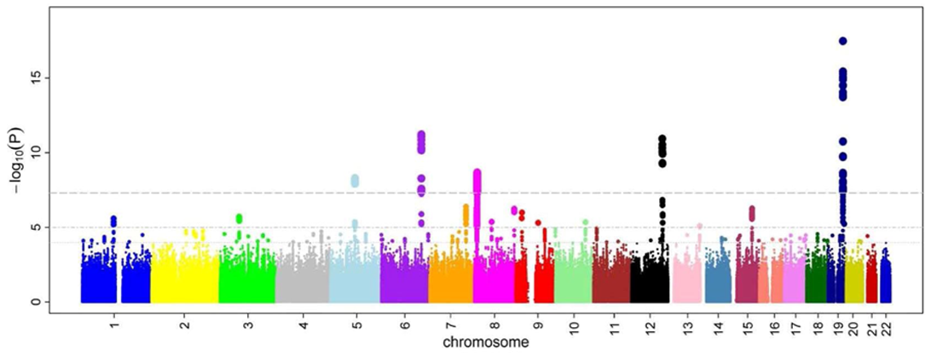
The key to finding significant associations?

Slide 6
Warning: R²
By the end of this lecture you will have seen the term R² being used in at least three different contexts:
1. The extent of linkage disequilibrium between two SNPs
2. The squared correlation between two variables (also known as ‘variance explained’
3. The imputation accuracy of a SNP

Slide 7
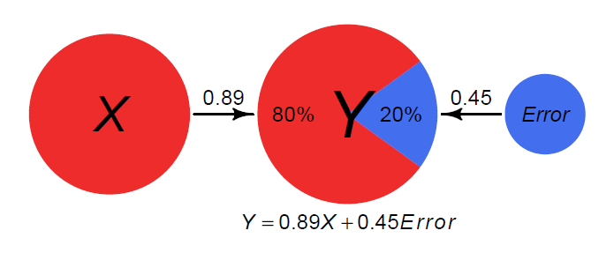
Variance explained
Great explanation here:
https://assessingpsyche.wordpress.com/2014/07/10/two-visualizations-for-explaining-variance-explained/
Var(y) = var(x) + var(error)
Variance explained:
R²=var(x) / var(y)
R²=0.8

Slide 8
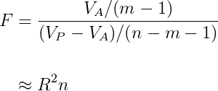
What determines the p-values?
Additive genetic variance of the SNP
Allele frequency
Effect size
Notes:
The effect size, sample size and allele frequency all

Slide 9
Scenario 1

Slide 10
Scenario 2

Slide 11
Quick summary
Power is increased if:
the tested SNP has higher R² with the causal variant
and the causal variant has higher R² with the phenotype
R²(SNP, phenotype) = R²(SNP, causal variant) x R²(causal variant, phenotype)
Observed SNP 1 tells us something about the causal variant
Observed SNP 2 ALSO tells us something about the causal variant
SNPs 1 and 2 tell us different things about the causal variant
Together, they can tell us more about the causal variant than either can on its own

Slide 12
What is Imputation
Example definition in the context of genome-wide association studies
Imputation is the prediction, both of SNPs not typed in the sample and genotypes missing in the sample, using observed genotypes in the sample and observed genotypes in a reference panel.
(Marchini and Howie, 2010)
Notes:
Imputation has several definitions:
In statistics, imputation is the process of replacing missing data with substituted values.
Imputed values may be obtained using a model based on available observed values
multiple regression
multiple imputation

Slide 13
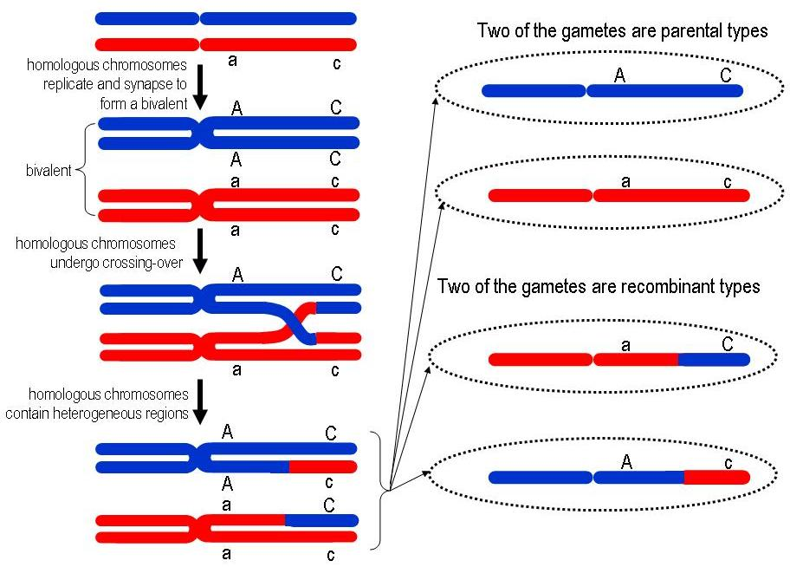
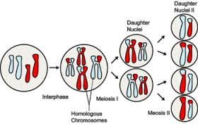
Recombination
Meiosis
Recombination
Approximately 100 recombination events across the genome at each meiosis
Notes:
The influence of recombination is that markers that are on the same chromosome in a parent are not necessarily co-inherited

Slide 14
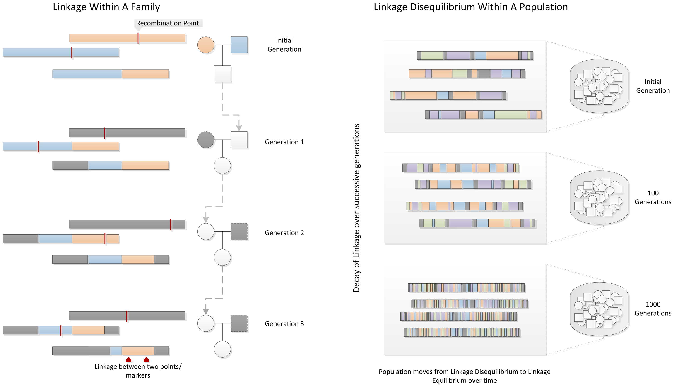
Notes:
If there was no recombination, knowledge of an allele at one SNP on the chromosome would be a perfect predictor (barring mutation) of the allele at every other SNP on the chromosome.
But recombination means that the further the SNP is away, the less predictable the SNP is.
The

Slide 15
Imputation process
SNPs
g/g a/c g/t g/a t/t a/t a/c
a/g t/c g/g g/g t/c t/a a/a
g/g c/c t/g g/g t/c t/a c/a
g/a t/t g/t g/a t/c a/a c/a
Study
samples
Genome-wide SNP array genotypes

Slide 16
Phase the genotype data
SNPs
g a g g t a a
g c t a t t c
a t g g t t a
g c g g c a a
g c t g t t c
g c g g c a a
g t g g t a c
a t t a c a a
Study
samples
Haplotypes are estimated using statistical methods

Slide 17
a g a g t t g a g g g a a c c t g a g a a
t g a g a c g a g g g a a a t t g a g a c
t g c g a c g g t g a t t c t c c a g a c
a g c g a c g a t g g t a c t t g a t c a
t a a g t t a g t a a t t c c c g a g c a
t g c a a t g a g g g a a a t t g t t a a
a g a g a c g g g g g a a a t t c t g c c
Reference haplotypes via sequencing studies
eg. 1000 Genomes Project
g a g g t a a
g c t a t t c
a t g g t t a
g c g g c a a
g c t g t t c
g c g g c a a
g t g g t a c
a t t a c a a

Slide 18
a g a g t t g a g g g a a c c t g a g a a
t g a g a c g a g g g a a a t t g a g a c
t g c g a c g g t g a t t c t c c a g a c
a g c g a c g a t g g t a c t t g a t c a
t a a g t t a g t a a t t c c c g a g c a
t g c a a t g a g g g a a a t t g t t a a
a g a g a c g g g g g a a a t t c t g c c
Reference haplotypes via sequencing studies
eg. 1000 Genomes Project
? g ? ? ? a ? ? g ? g ? ? ? t ? ? a ? ? a
? g ? ? ? c ? ? t ? a ? ? ? t ? ? t ? ? c
? a ? ? ? t ? ? g ? g ? ? ? t ? ? t ? ? a
? g ? ? ? c ? ? g ? g ? ? ? c ? ? a ? ? a
? g ? ? ? c ? ? t ? g ? ? ? t ? ? t ? ? c
? g ? ? ? c ? ? g ? g ? ? ? c ? ? a ? ? a
? g ? ? ? t ? ? g ? g ? ? ? t ? ? a ? ? c
? a ? ? ? t ? ? t ? a ? ? ? c ? ? a ? ? a

Slide 19
a g a g t t g a g g g a a c c t g a g a a
t g a g a c g a g g g a a a t t g a g a c
t g c g a c g g t g a t t c t c c a g a c
a g c g a c g a t g g t a c t t g a t c a
t a a g t t a g t a a t t c c c g a g c a
t g c a a t g a g g g a a a t t g t t a a
a g a g a c g g g g g a a a t t c t g c c
Reference haplotypes via sequencing studies
eg. 1000 Genomes Project
g a g g t a a
g c t a t t c
a t g g t t a
g c g g c a a
g c t g t t c
g c g g c a a
g t g g t a c
a t t a c a a
Imputation of unobserved alleles via matching of shared haplotypes

Slide 20
a g a g t t g a g g g a a c c t g a g a a
t g a g a c g a g g g a a a t t g a g a c
t g c g a c g g t g a t t c t c c a g a c
a g c g a c g a t g g t a c t t g a t c a
t a a g t t a g t a a t t c c c g a g c a
t g c a a t g a g g g a a a t t g t t a a
a g a g a c g g g g g a a a t t c t g c c
Reference haplotypes via sequencing studies
eg. 1000 Genomes Project
a g a g t a g a g g g t a c t t g a t c a
t g c g a c g g t g a t t c t t c t g c c
t a a a a t g a g g g a a a t t g t t a a
t g a g a c g a g g g a a c c c g a g c a
a g c g a c g a t g g t a a t t c t g c c
a g a g a c g a g g g a a c c t g a g a a
t g c a a t g a g g g a a a t t g a g a c
t a a g t t a g t a a t t c c t g a t c a
Imputation of unobserved alleles via matching of shared haplotypes

Slide 21
We will now look at
what reference panels are available
how phasing works

Slide 22
Reference panels
Reference | Year | # haplotypes | # populations | # variants
HAPMAP 2 | 2006 | 420 | 3 | 2,139,483
HAPMAP 3 | 2009 | 2,368 | 11 | 1,440,616
1000GP Pilot | 2010 | 358 | 3 | 14,894,361
1000GP 2010 | 2010 | 1,258 | 14 | 22,242,654
1000GP Interim | 2011 | 2,186 | 14 | 38,558,931
1000GP Phase 1 | 2012 | 2,186 | 14 | 38,219,282
Reference | Year | # haplotypes | populations | # variants
1000GP Final | 2014 | ~5,000 | 25 | ~80,000,000
UK10K | 2013/14 | ~8,000 | UK | ~50,000,000
GoT2D | 2013/14 | ~5,600 | European | ~27,000,000
GoNL | 2013/14 | 1,000 | NL | ~20,000,000
HRC | 2016 | ~65,000 | 20 (most Eur) | ~40,000,000
TOPMED | 2021 | ~300,000 | Global | ~400,000,000

Slide 23
The Haplotype Reference Consortium
COHORT | Samples | Coverage
1000 Genomes | 2500 | 4x
UK10K | 4000 | 6.5x
GoT2D | 2800 | 4x
Sardinia | 6000 | 4x
GoNL | 750 | 12x
Finns | 2000 | 4x
AMD | 3000 | 4x
HUNT | 1000 | 4x
MTFS | 1000 | 10x
ORCADES | 400 | 4x
Italian Isolates | 550 | >4x
HELIC | 2000 | >1x
Bipolar | 4000 | >6x
Crohn's disease | 3000 | 4x
Ulcerative colitis | 2000 | 2x
TOTAL | 35000

Slide 24
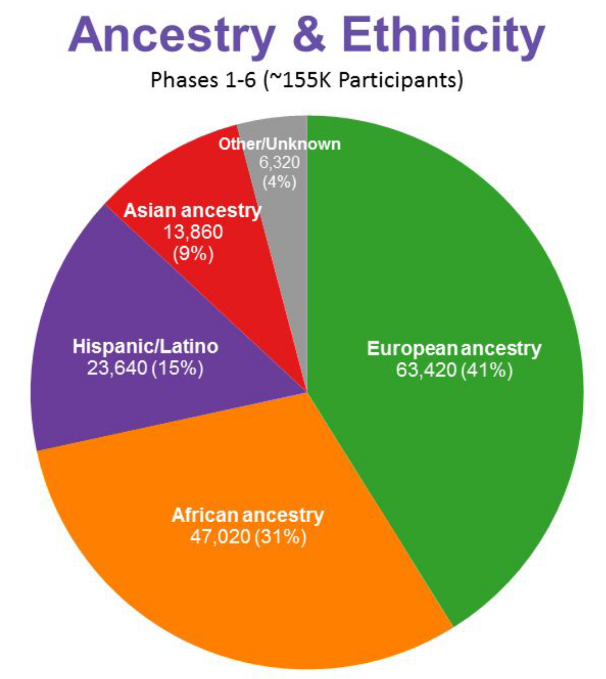
TOPMED

Slide 25
Inferring haplotypes from genotype data – using relatives
Family genotypes
Child haplotypes
SNP | Mother | Father | Child
1 | AA | aa | Aa
2 | BB | bb | Bb
SNP | Maternal | Paternal
1 | A | a
2 | B | b
SNP | Mother | Father | Child
1 | Aa | aa | Aa
2 | BB | Bb | Bb
SNP | Maternal | Paternal
1 | A | a
2 | B | b
SNP | Mother | Father | Child
1 | Aa | Aa | Aa
2 | Bb | Bb | Bb
SNP | Maternal | Paternal
1 | ? | ?
2 | ? | ?

Slide 26
Inferring haplotypes from genotype data – without relatives
6 adjacent SNPs, genotyped in one individual
Possible haplotypes
SNP | Genotype
1 | AA
2 | GC
3 | GG
4 | TT
5 | AC
6 | TT
SNP | Opt 1 | Opt 2 | Opt 3 | Opt 4
1 | A | A | A | A
2 | G | G | C | C
3 | G | G | G | G
4 | T | T | T | T
5 | A | C | A | C
6 | C | T | T | T
With a sample of many individuals, we might find that, e.g. there are some individuals with
2: GG and 5: CC, or
2: CC and 5: AA
but never 2: GG and 5: AA; or 2: CC and 5: CC
What would that tell us about which of the possible haplotypes are likely?

Slide 27
Phasing software
Objective: convert genotype data to haplotype data
- e.g. genotype data is 1 column per individual; haplotype data is 2 columns per individual
Software | Notes
FastPhase | Maximum likelihood; can be performed in large samples but algorithm considers only a few markers at a time
Long range phasing | Introduces the idea of matching large sections of chromosomes by identifying plausible haplotypes in a sample. Requires large proportion of population to be in sample (e.g. Iceland)
HAPIUR | Uses hidden markov model and can incorporate trio or duo information; fast for large samples
ShapeIt v2 | Uses recombination rates to break up chromosomes, uses ‘surrogate families’ to infer likely haplotypes
Eagle v2 | Combines long range phasing with inferred distant family structures. Can use a reference panel. Scales to very large samples, currently the best software

Slide 28
Imputation software
Impute2 http://mathgen.stats.ox.ac.uk/impute/impute_v2.html
minimac3 http://genome.sph.umich.edu/wiki/Minimac3
(Not much difference in performance.)
There now exist online cloud-based imputation servers – it’s a very good idea to use these rather than running your own imputations!
https://imputationserver.sph.umich.edu/index.html
- Uses minimac (rows = individuals, columns = SNPs)
https://imputation.sanger.ac.uk/
- Uses impute2 (rows = SNPs, columns = individuals)
https://imputation.biodatacatalyst.nhlbi.nih.gov/
- Similar to Michigan but includes TOPMED reference panel

Slide 29
Quick summary
Genotyping is cheap, but only captures a small proportion of common variants
Sequencing captures all variants, but is expensive and can’t be done in large sample sizes
Imputation combines the two – inferring the sequences that lie between the genotypes using a reference sample of sequence data

Slide 30
Genotype probabilities
Dosage data: 3 columns per individual
Probability that individual 3 is heterozygous at SNP 2
SNP | 1.1 | 1.2 | 1.3 | 2.1 | 2.2 | 2.3 | 3.1 | 3.2 | 3.3
1 | 1 | 0 | 0 | 0 | 1 | 0 | 0.2 | 0.8 | 0
2 | 1 | 0 | 0 | 0.6 | 0.3 | 0.1 | 0.1 | 0.1 | 0.8
3 | 0.9 | 0.1 | 0 | 0.3 | 0.4 | 0.3 | 0.2 | 0.1 | 0.7
1 | 0 | 1 | 1
2 | 0 | 0 | 2
3 | 0 | 1 | 2
Best guess
genotypes

Slide 31
Assessing imputation accuracy
Method 1: Concordance
For every genotyped SNP, pretend you don’t know the genotype, impute it, then see what proportion of genotypes were imputed correctly
What is the average % correct for an individual? This is the Concordance
Typically expect to obtain >95% concordance averaged across all genotypes and all individuals
Method 2: Info scores
- For every SNP estimate the probability that it was imputed correctly.
- Hard because we don’t know the truth!
- Different methods for different software
Example for impute2…

Slide 32
Impute2 info scores (accuracy)
SNP | 1.1 | 1.2 | 1.3 | 2.1 | 2.2 | 2.3 | 3.1 | 3.2 | 3.3
1 | 1 | 0 | 0 | 0 | 1 | 0 | 0.2 | 0.8 | 0
2 | 1 | 0 | 0 | 0.6 | 0.3 | 0.1 | 0.1 | 0.1 | 0.8
3 | 0.9 | 0.1 | 0 | 0.3 | 0.4 | 0.3 | 0.2 | 0.1 | 0.7
High imputation accuracy
Intermediate accuracy
Low accuracy
Each imputed SNP will have an info score
Info scores are between 0 and 1
They reflect the amount of certainty for imputation at a particular SNP
Info score also known as R²

Slide 33
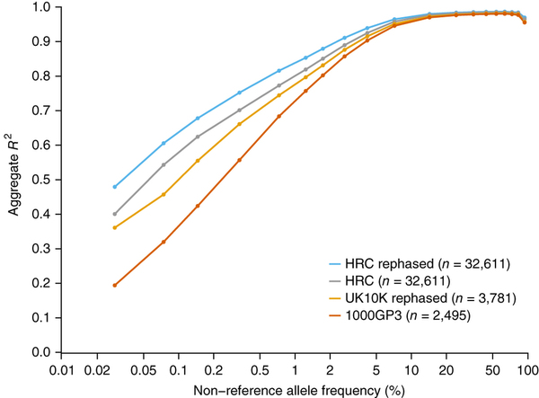
Imputation accuracy

Slide 34
How does accuracy factor into power?
There is an interesting interplay between
imputation accuracy
statistical power in GWAS
allele frequencies…

Slide 35
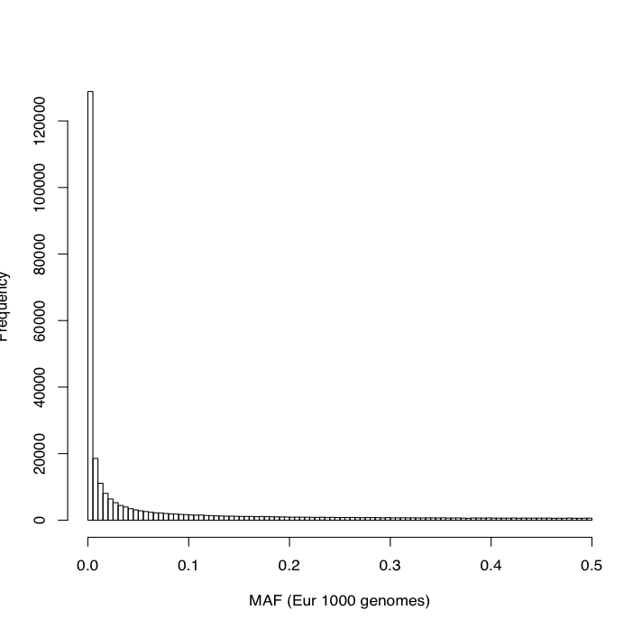
Distribution of allele frequencies
SNP chip
Sequence data
After removing SNPs with low imputation accuracy, typically <10 million remain
- Almost all of them will be MAF > 0.01

Slide 36
Imputation accuracy and power?
Additive genetic variance of the SNP
Allele frequency
We want to maximise R²
Rare variants have lower power – eg. 0.01 * 0.99 = 0.0099
eg. 0.4 * 0.6 = 0.24
Higher imputation accuracy = “closer to the causal variant”
Rare variants have lower power
AND
Rare variants have lower imputation accuracy
Effect size

Slide 37
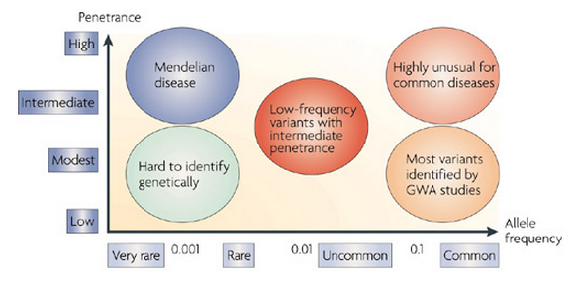
(McCarthy et al., 2008)
Sequencing still important for assaying rare variants
Notes:
In humans, linkage studies have been successful in identifying highly penetrant genetic variants of large effect (odds ratio >100) underlying hundreds, if not thousands of Mendelian diseases
GWAS have identified 1000’s of SNPs that are strongly associated with common traits. Most of these SNPs are common (MAF >5%)
SNPs identified by GWAS explain only a part of the total heritability of these traits and less common SNPs may play a substantial role in identifying more robust associations.

Slide 38
Summary of single-variant associations
WGS, N ≤ 3,621
31 traits
13,074,236 SNVs
1,122,542 biallelic INDELs
18,741 large deletions
MAF≥0.1%
No findings here!
rs138326449-A
(EAF=0.3%, -1.36 SD TG)
rs74577862-A
(EAF=2.6%, -0.9 SD adipon.)
Classical lipid variants define extremes of risk for 31 traits
Greater N required for novel discoveries
Notes:
Slide 9 Single-variant results
For single marker tests, we first fitted linear models on standardised trait residuals to test associations of allele dosages with 13,074,236 SNVs, 1,122,542 biallelic INDELs (MAF≥0.1%) and 18,741 large deletions in the WGS samples (‘WGS sample’). A total of 27 independent loci had p-value≤4.6x10⁻¹⁰ in either the WGS or WGS+GWA sample across the 31 core traits. Of these, 25 were known.
The remaining 25 loci reaching genome-wide significance included common, low frequency and rare variants tagging known associations with adiponectin levels (CDH13 and ADIPOQ), serum lipids (APOB, APOC3-APOA1, APOE, CETP, LIPC, LPL, PCSK9, SORT1-PSRC1-CELSR2), C-reactive protein (LEPR), hemoglobin levels (HFE) and fasting glycemic traits (G6PC2-ABCB11).
Two were new associations. A rare splice variant (rs138326449) in the APOC3 gene associated with triglyceride (TG) levels was recently described by us and others as associated with TG and coronary artery disease risk. The second was a low frequency intronic variant in ADIPOQ associated with adiponectin levels (rs74577862-A, effect allele frequency [EAF]=2.6%, Beta (SE)=-0.915 standard deviation [SD] units (0.091), p-value=9.83x10⁻²⁴). This variant was strongly supported in the GWA sample (combined p-value=3.04x10⁻⁶⁴) and was further replicated in independent samples ³⁹.
As summarised in this figure, the picture emerging from this large-scale comparison is that single marker association testing follows closely the expected relationship between EAF and effect size (beta) as dictated by study power. In addition, there is compelling evidence that the classical lipid alleles (and notably the APOE variant rs7412) represent extremes of genetic risk for a wide range of biomedical traits where our sample is fully powered.
Given the high degree of coverage of the human genome achieved in our study, results here do suggest that across these traits future “low hanging fruit” discoveries of low frequency variants of high penetrance (as defined by study power) are highly unlikely. This also suggests that sequencing a comparable number of samples is unlikely to yield

Slide 39
Quick summary
Imputation is a probabilistic process
Most common variants can be imputed to high accuracy
Sequencing still may have an important role for detecting rare variant associations

Slide 40
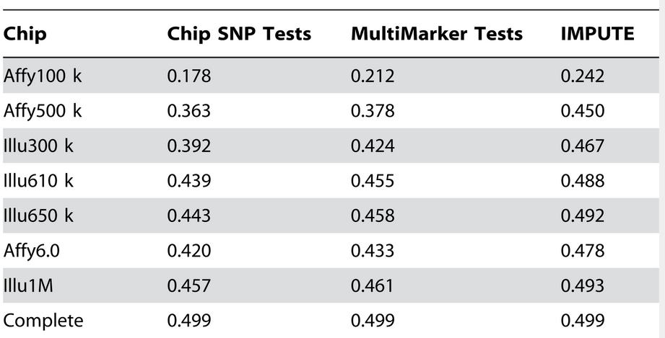
How much of a power boost is there?
(Spencer et al., 2009)
Notes:
Power for each chip
They simulated data under the assumption that a particular allele is causal
Then looked to see whether any SNPs on the respective genotyping chip, within a large region around the causal SNP attain the specified significance level
Sample size of 2000 cases and 2000 controls
Relative risk at the causal SNP of 1.3
P-value threshold of 5×10−7

Slide 41
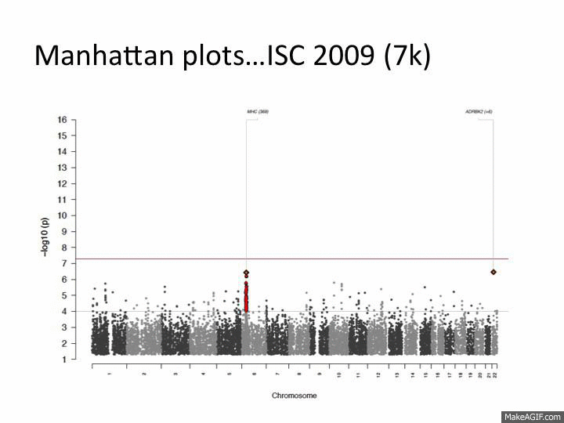

Slide 42
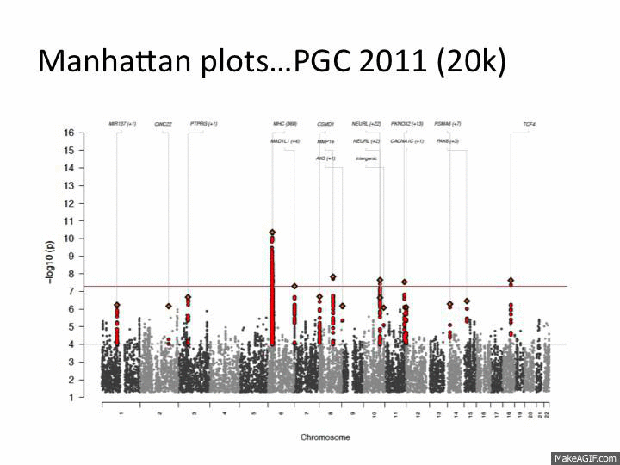

Slide 43
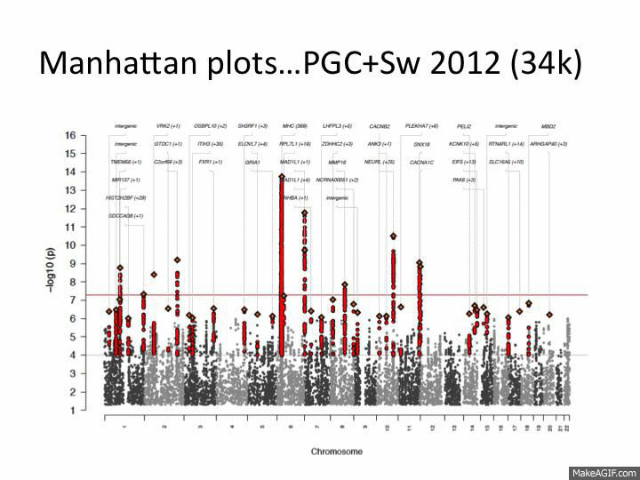

Slide 44
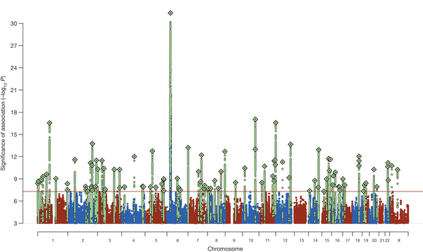
2014 (150k)

Slide 45
Increasing sample sizes
Study 1: 5000 samples, Affymetrix 5.0
Study 2: 8000 samples, Illumina 1M
Combined, study 1 and 2 only have 120,000 SNPs in common
For those SNPs, the sample size is 13000
If we impute both datasets to the same reference panel then every SNP can be meta-analysed with a sample size of 13000

Slide 46
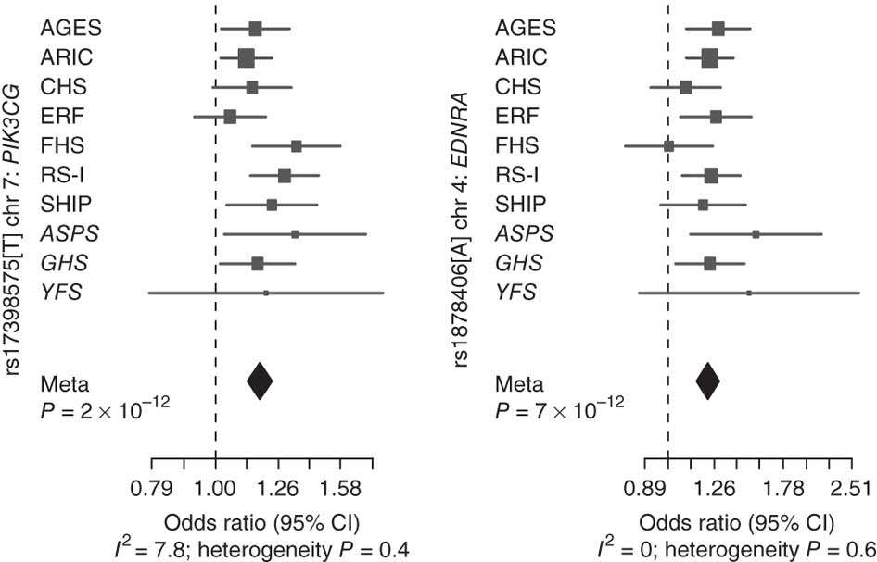
Meta-analysis
(Bis et al., 2011)
A meta-analysis of genome-wide association data in 31,211 participants of European ancestry from nine large studies
Studies used various DNA arrays to generate genotype data but all imputed to approximately 2.5 million SNPs described in the HapMap.
Notes:
e.g
ARIC Affymetrix Genome-Wide Human SNP Array 6.0
CHS Illumina 370CNV Duo® BeadChip

Slide 47
Finding the causal variant
After imputation, consider that all common variants will be present in your data
This suggests that for many associations the causal variant will be there
Many approaches exist to try to infer the causal variant, and also the relevant gene
Note that it is not as straightforward as finding the SNP with the lowest p-value
The causal variant might have lower imputation accuracy
There might be many SNPs in high LD with the causal variant
Winner’s curse could make one of those other SNPs have a larger effect size
Useful to use external information e.g. variant effect predictions, transcription factor binding sites, etc.

Slide 48
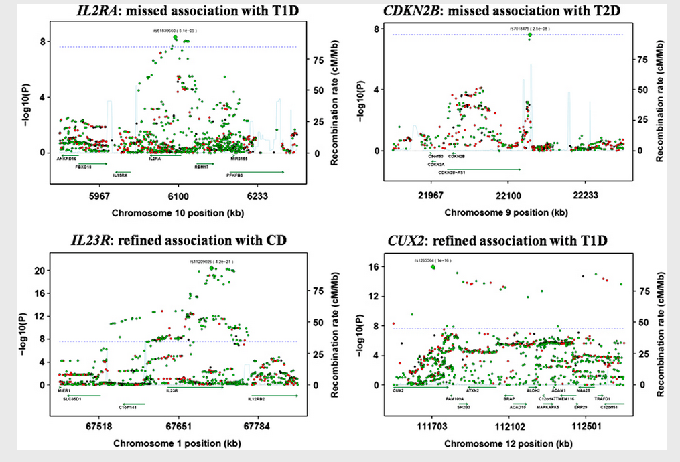
Fine-map association
(Huang et al., 2012)
Wellcome Trust Case Control Consortium (WTCCC) Phase I genotype data was re-analyzed after imputation using the 1000 genomes as reference
Identifies two “new” associations which were already confirmed in other studies
Notes:
Two “new associations”:
Within the IL2RA gene for association with type 1 diabetes
In proximity of the CDKN2B gene for association with type 2 diabetes
Refined associations:
One in exon 9 of IL23R in association with Crohn’s disease,
predicted to be probably damaging by PolyPhen2
A variant is in the CUX2 gene region for association with type 1 diabetes
evidence of association two orders of magnitude higher (10-14 to 10-16)

Slide 49
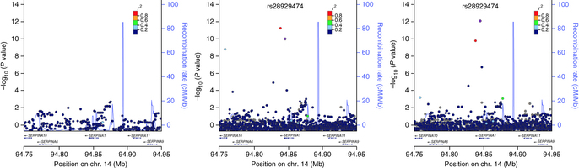
HapMap2, 1000 Genomes, HRC
Association signal for the α1-antitrypsin phenotype at the SERPINA1 locus

Slide 50
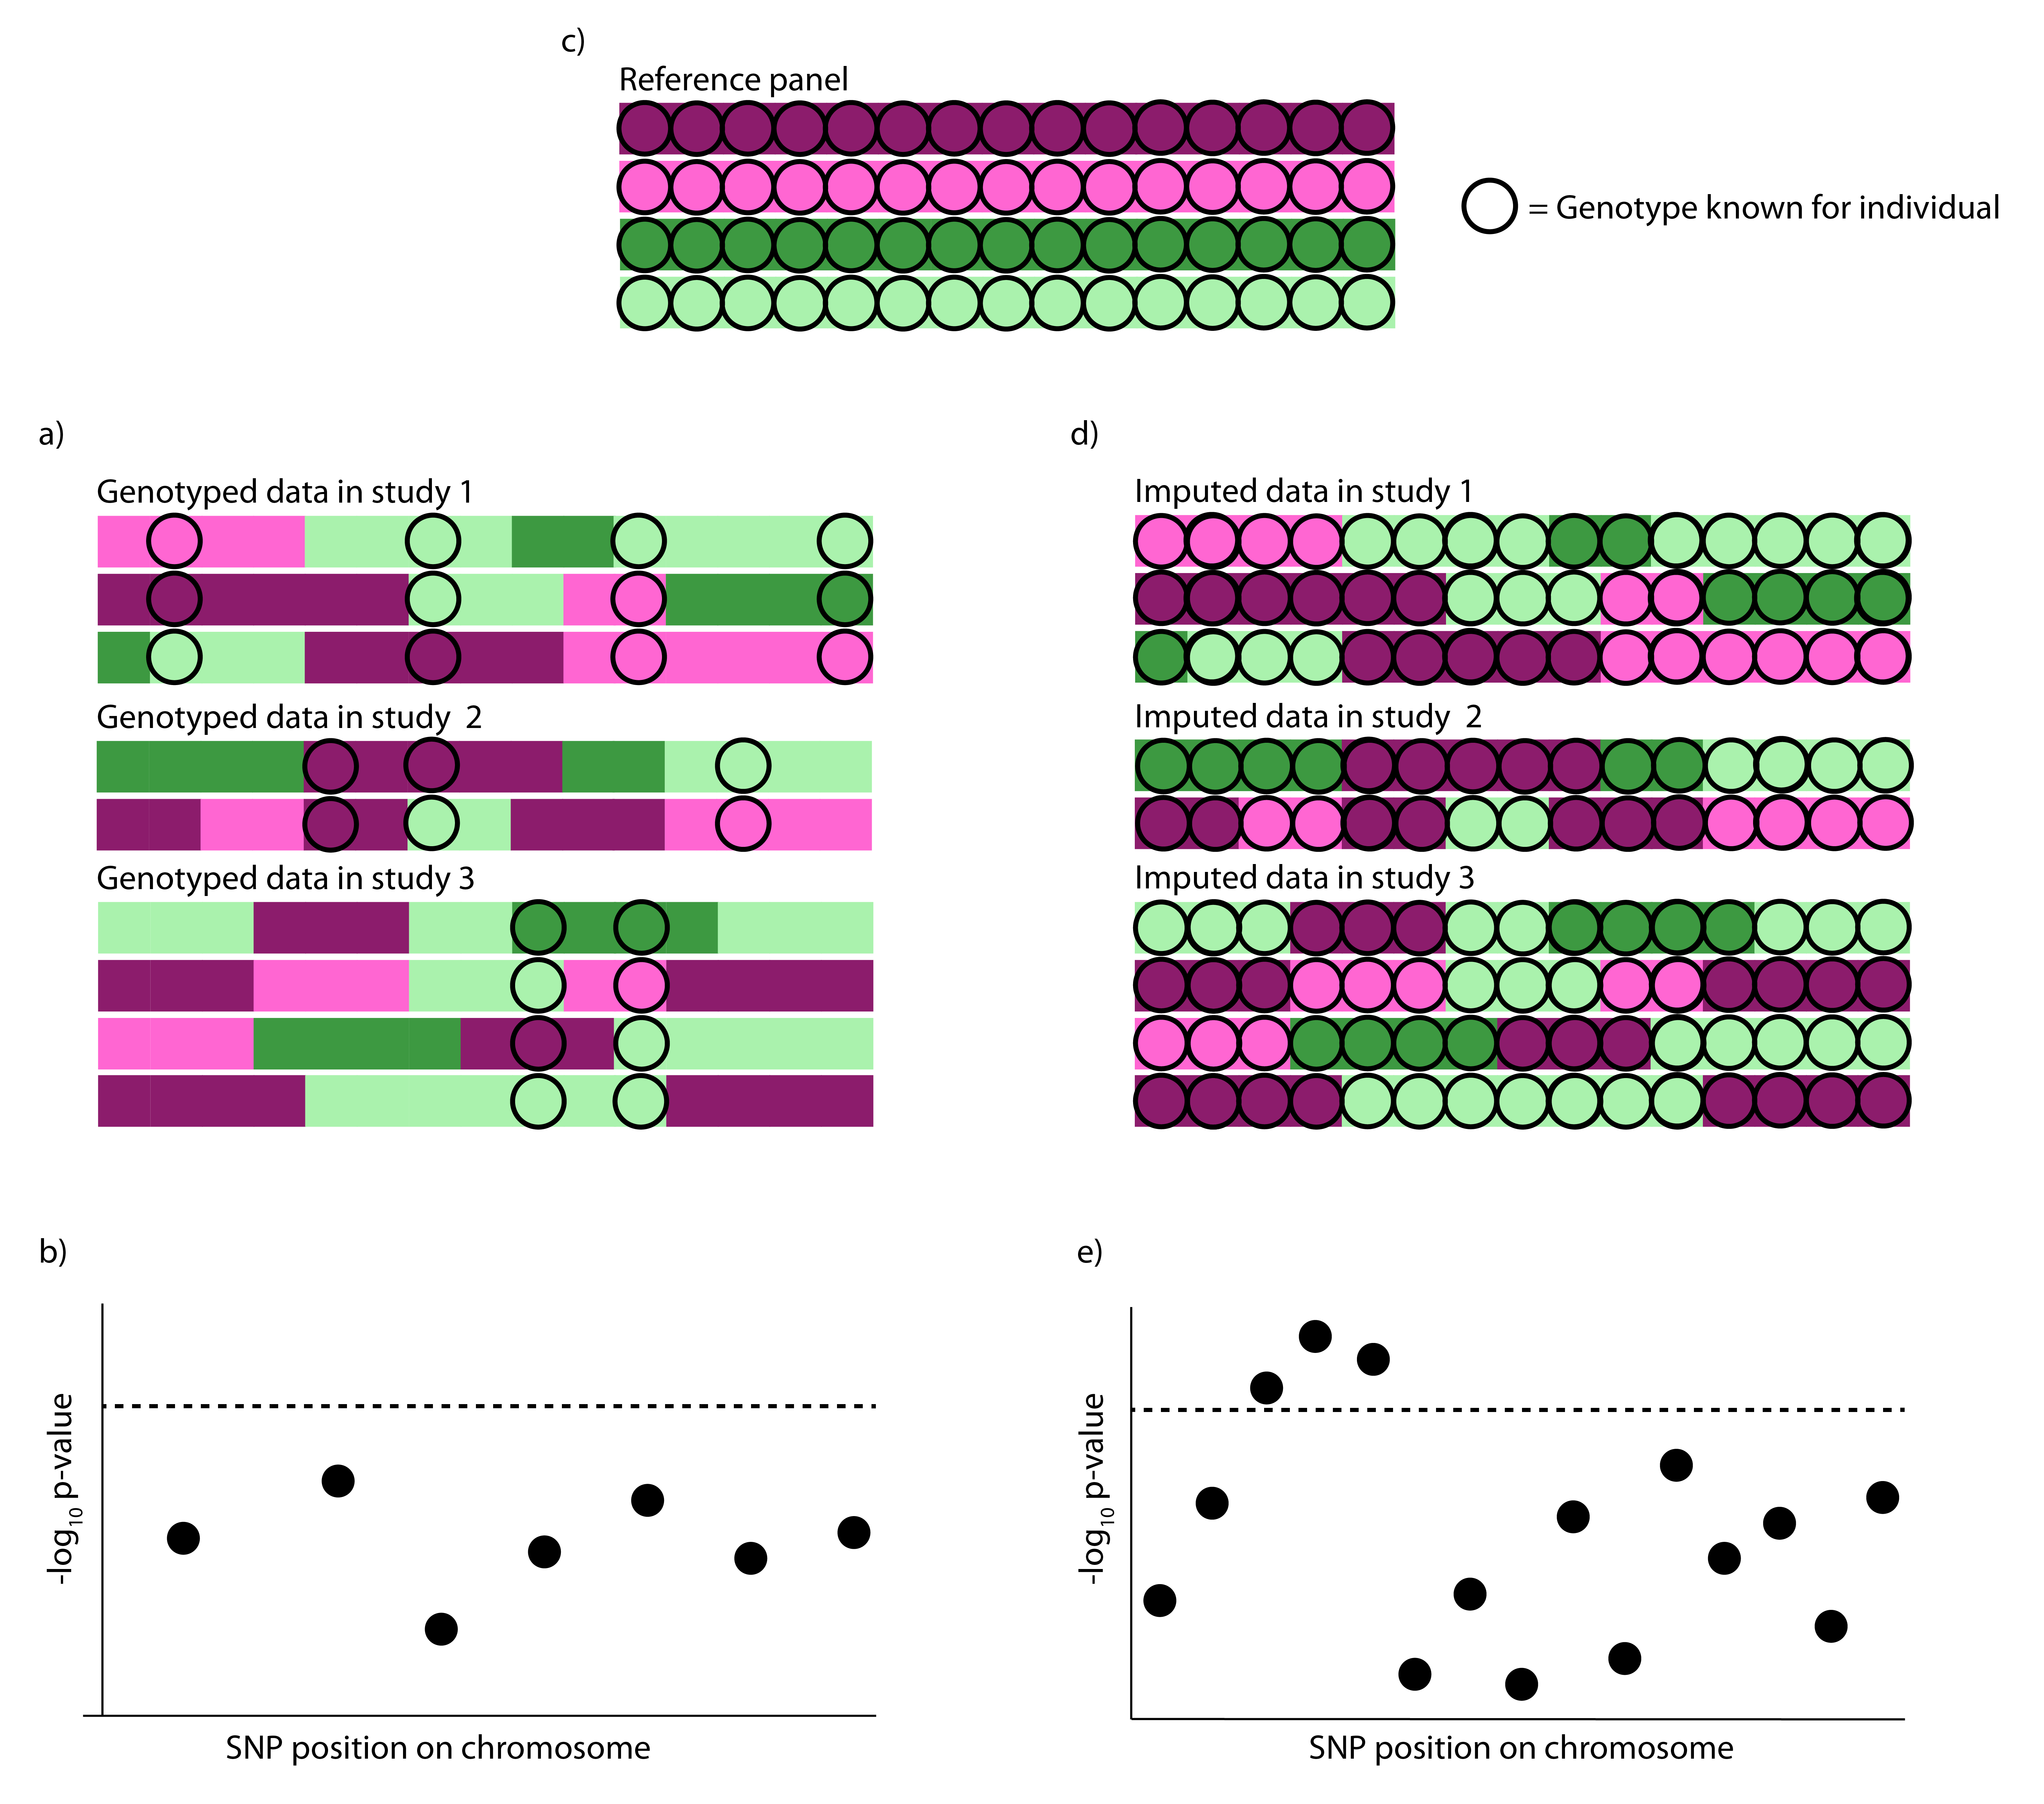
Imputation makes sure all studies have the same variants

Slide 51
Final words
Perhaps most important value of imputation is that it allows many different studies to be used together – very much a practical solution
Also – consider the possibility that (for common variants) it is almost always the case that the causal variant of an association is amongst your SNPs

Slide 52
References
Marchini, J., and Howie, B. (2010). Genotype imputation for genome-wide association studies. Nature reviews Genetics 11, 499-511.
Huang, J., Ellinghaus, D., Franke, A., Howie, B., and Li, Y. (2012). 1000 Genomes-based imputation identifies novel and refined associations for the Wellcome Trust Case Control Consortium phase 1 Data. European journal of human genetics : EJHG 20, 801-805.
Hindorff, L.A., Sethupathy, P., Junkins, H.A., Ramos, E.M., Mehta, J.P., Collins, F.S., and Manolio, T.A. (2009). Potential etiologic and functional implications of genome-wide association loci for human diseases and traits. Proceedings of the National Academy of Sciences of the United States of America 106, 9362-9367.
Spencer, C.C., Su, Z., Donnelly, P., and Marchini, J. (2009). Designing genome-wide association studies: sample size, power, imputation, and the choice of genotyping chip. PLoS genetics 5, e1000477.
Bis, J.C., Kavousi, M., Franceschini, N., Isaacs, A., Abecasis, G.R., Schminke, U., Post, W.S., Smith, A.V., Cupples, L.A., Markus, H.S., et al. (2011). Meta-analysis of genome-wide association studies from the CHARGE consortium identifies common variants associated with carotid intima media thickness and plaque. Nature genetics 43, 940-947.
International HapMap, C. (2005). A haplotype map of the human genome. Nature 437, 1299-1320.
Clark, A.G. (1990) Inference of haplotypes from PCR-amplified samples of diploid populations. Mol Biol Evol, 7, 111-122.
Excoffier, L. and Slatkin, M. (1995) Maximum-likelihood estimation of molecular haplotype frequencies in a diploid population. Mol Biol Evol, 12, 921-927.
Huang, J., Howie, B., McCarthy, S., Memari, Y., Walter, K., Min, J.L., Danecek, P., Malerba, G., Trabetti, E., Zheng, H.F. et al. (2015) Improved imputation of low-frequency and rare variants using the UK10K haplotype reference panel. Nature communications, 6, 8111.
Howie, B., Marchini, J., and Stephens, M. (2011). Genotype imputation with thousands of genomes. G3 1, 457-470.
International HapMap, C., Altshuler, D.M., Gibbs, R.A., Peltonen, L., Altshuler, D.M., Gibbs, R.A., Peltonen, L., Dermitzakis, E., Schaffner, S.F., Yu, F., et al. (2010). Integrating common and rare genetic variation in diverse human populations. Nature 467, 52-58.
McCarthy, M.I., Abecasis, G.R., Cardon, L.R., Goldstein, D.B., Little, J., Ioannidis, J.P., and Hirschhorn, J.N. (2008). Genome-wide association studies for complex traits: consensus, uncertainty and challenges. Nature reviews Genetics 9, 356-369.
Delaneau, O., Marchini, J., Genomes Project, C., and Genomes Project, C. (2014). Integrating sequence and array data to create an improved 1000 Genomes Project haplotype reference panel. Nature communications 5, 3934.

